Slide 1
NLP · MACHINE LEARNING · CUSTOMER ANALYTICS
Customer Review Sentiment
Analysis using NLP
①
Prepared by:
Shanmuga Priya RK
V Sanu
Mrinmoy Nanda
Abhishek Shanker
Shweta Jayprakash Daware
Summit Baruah
Mentor:
Dilaver Basha
Live deployment: streamlit.app | Model portfolio: 7 algorithms | Dataset: 1,440 reviews
Notes:
1

Slide 2
ROADMAP
What We Will Cover Today
A complete, production-grade walkthrough — from raw customer language to a deployed prediction engine.
01
Business Problem & Objective
05
Model Building
Why sentiment intelligence matters
7 algorithms, classical ML to neural & lexicon-based
02
Dataset & Exploratory Analysis
06
Comparison & Evaluation
1,440 reviews, distributions, language patterns
Metrics, confusion matrices, the winning model
03
Text Preprocessing
07
Deployment & Roadmap
Turning noisy text into model-ready signal
Streamlit app, challenges, what's next
04
Feature Engineering
TF-IDF vectorization & train/test design
Notes:
2

Slide 3
SECTION 01 — BUSINESS CONTEXT
Project Objective
Build an automated NLP system that classifies customer reviews into Positive, Neutral, or Negative sentiment.
1
2
3
4
Understand Feedback
Detect Issues Early
Improve Satisfaction
Enable Data-Driven Decisions
Convert unstructured review text into structured, analyzable sentiment signal at scale.
Flag negative reviews the moment they are posted, before they compound into churn.
Give CX and product teams a prioritized, evidence-based view of what to fix.
Feed sentiment trends into dashboards that guide roadmap and marketing decisions.
KEY TAKEAWAY The end system must move a customer sentence to an actionable label in real time — not just power a one-off analysis notebook.
Notes:
3

Slide 4
SECTION 02 — DATA
Dataset Overview
1,440 real smartphone customer reviews, each with a title, star rating, and full review body.
Source Columns
1,440
3
Column | Description
title | Short customer-written headline for the review
rating | Star rating given by the customer (1–5)
body | Full free-text customer review content
Total Reviews
Raw Columns
1 – 5
0
Rating → Sentiment Mapping
Rating Range
Missing Values
4 – 5 stars
Positive
0
3 stars
Neutral
DUPLICATE RECORDS
1 – 2 stars
Negative
Rating Summary Statistics
Mean | Std Dev | Min | Median | Max
3.17 | 1.58 | 1 | 4.0 | 5
An average rating of 3.17 and a median of 4. This indicates that the dataset is slightly skewed toward positive reviews while still containing a good mix of negative and neutral opinions, making it suitable for sentiment analysis.
Notes:
4

Slide 5
SECTION 02 — EXPLORATORY DATA ANALYSIS
Rating Distribution
How customers actually rated their smartphones — before any sentiment mapping is applied.
Business Insight
1★ and 5★ dominate — customers write reviews mostly at emotional extremes, a well-known review-platform bias.
Only 199 reviews (13.8%) sit at 3★, foreshadowing a thin Neutral class for modeling.
A near-bimodal shape confirms this is a genuine mix of promoters and detractors — ideal for a 3-class classifier.
Notes:
5

Slide 6
SECTION 02 — EXPLORATORY DATA ANALYSIS
Sentiment Distribution
After mapping ratings to sentiment classes, the dataset skews positive with a real but thin Neutral segment.
Positive
50.6%
729 reviews
Negative
35.6%
512 reviews
Neutral
13.8%
199 reviews
KEY TAKEAWAY Positive-skewed but genuinely 3-class data — with Neutral at only 13.8%, we anticipated class-imbalance challenges going into modeling.
Notes:
6

Slide 7
SECTION 02 — EXPLORATORY DATA ANALYSIS
Review Length & Word Count
Understanding how much customers write helps size preprocessing and vectorization choices.
Review Length (characters)
Word Count
333
277
58
49
Mean
Median
Mean
Median
9
2,536
2
391
Min
Max
Min
Max
Reviews range from a 9-character one-liner to a 2,536-character deep dive — a wide spread that TF-IDF and padding decisions must accommodate.
Average review = 58 words, positively skewed (most reviews 30–70 words). Neutral reviews average 61.9 words — slightly longer than Positive (57.5) or Negative (58.0), suggesting hedged opinions need more words to explain.
Notes:
7

Slide 8
SECTION 02 — EXPLORATORY DATA ANALYSIS
Top Frequent Words & Bigrams
47,786 total words after cleaning reveal exactly what customers talk about.
Discriminating Bigrams by Sentiment
POSITIVE
NEGATIVE
"battery life"
"dont buy"
"camera quality"
"worst phone"
"good phone"
"waste money"
"value money"
"quality poor"
Notes:
8

Slide 9
SECTION 02 — EXPLORATORY DATA ANALYSIS
Vocabulary Themes at a Glance
47,786 words, one dominant story: this is a phone, and customers judge it on camera, battery, and value.
good
mobile
phone
camera
life
battery
price
samsung
display
quality
dont buy
worst
value
screen
day
KEY TAKEAWAY Product-attribute words (camera, battery, display) co-occur with both praise and complaints — signaling the need for future aspect-based sentiment analysis, not just overall polarity.
Notes:
9

Slide 10
SECTION 03 — TEXT PREPROCESSING
The Text Cleaning Pipeline
Nine sequential steps transform noisy customer language into consistent, model-ready tokens.
1
Lowercase
2
Remove URLs
3
Remove HTML tags
→
→
Treats "Good" and "good" as the same token
Strips links that add no sentiment signal
Cleans markup leaked from web-scraped reviews
4
Remove punctuation
5
Remove numbers
6
Remove special chars
→
→
Removes symbols that fragment tokens
Drops digits (model sizes, prices) as noise
Strips emojis / non-alphabetic symbols
7
Remove stopwords
8
Tokenization
9
Lemmatization
→
→
Removes "the", "is", "and" — low signal words
Splits text into individual word units
Reduces words to base form ("running" → "run")
Notes:
10

Slide 11
SECTION 03 — TEXT PREPROCESSING
Preprocessing in Action
A real review from the dataset, traced end-to-end through the cleaning pipeline.
ORIGINAL REVIEW (title: "Horrible product", rating: 1★)
“Horrible product. Very disappointed with the overall performance from Samsung.”
↓
CLEAN, LEMMATIZED TOKENS → fed into TF-IDF vectorizer
horrible product disappointed overall performance samsung
KEY TAKEAWAY Nine words survive from fourteen — every remaining token carries direct sentiment or product-attribute meaning, which is exactly what a classifier needs.
Notes:
11

Slide 12
SECTION 04 — FEATURE ENGINEERING
Train-Test Split & TF-IDF Vectorization
Converting cleaned text into numeric feature vectors a machine learning model can learn from.
80 / 20 Train-Test Split
Sparse TF-IDF Matrix (conceptual)
1,152 Training Samples (80%)
288
(20%)
random_state = 42, stratified by class order — ensures reproducibility across all 7 model runs.
TF-IDF Vectorizer Configuration
Max features
3,000
Input
clean_text column
Output shape (train)
1,152 × 3,000
Each cell = one word's TF-IDF weight for one review. Most cells are zero (sparse) since any single review uses a tiny fraction of the 3,000-word vocabulary.
Output shape (test)
288 × 3,000
Down-weights words common across all reviews; up-weights rare, distinctive ones.
"disappointed" or "excellent" — rarer, sentiment-loaded — get more weight than "phone"
Notes:
12

Slide 13
SECTION 05 — MODEL BUILDING
Seven Modeling Approaches, One Benchmark
We deliberately spanned lexicon-based, classical ML, ensemble, and neural methods to find the best accuracy-interpretability trade-off.
1
2
3
4
5
6
7
Logistic Regression
Naive Bayes
Random Forest
SVM
VADER
XGBoost
ANN
Linear, probabilistic baseline
Fast, probabilistic, text-native
Bagged ensemble of decision trees
Max-margin linear classifier
Lexicon & rule-based, no training
Boosted gradient tree ensemble
Multi-layer perceptron (deep learning)
KEY TAKEAWAY Every model shares the same TF-IDF input and 80/20 split — an apples-to-apples benchmark, not a cherry-picked comparison.
Notes:
13

Slide 14
SECTION 06 — COMPARISON & EVALUATION
Evaluation Metrics — Technical & Business View
Every metric answers a different business question about the deployed classifier.
Accuracy
Precision
% of all reviews classified correctly
Of reviews flagged Negative, how many really were?
"Overall, how often can we trust the system?"
"How much do we trust each Negative alert?" (avoids false-alarm fatigue)
Recall
F1-Score
Of all truly Negative reviews, how many did we catch?
Harmonic balance of Precision & Recall
"Are we missing real complaints?" (directly tied to churn risk)
"Single number to rank models fairly on imbalanced classes"
Notes:
14

Slide 15
SECTION 06 — COMPARISON & EVALUATION
Model Comparison — Head to Head
Same data, same split, same features. Seven algorithms, ranked on real held-out performance.
Model | Accuracy | Precision | Recall | F1-Score | Best Suited For
Logistic Regression | 79.51% | 0.78 | 0.80 | 0.74 | Fast, interpretable production baseline
SVM (LinearSVC) | 79.17% | 0.77 | 0.79 | 0.77 | Best-balanced classifier across all classes
Random Forest | 76.74% | 0.66 | 0.77 | 0.71 | Feature-importance / explainability needs
XGBoost | 76.74% | 0.73 | 0.77 | 0.73 | Slight edge in handling non-linear patterns
ANN (MLP) | 73.61% | 0.72 | 0.74 | 0.72 | Foundation for future deep-learning work
Naive Bayes | 72.22% | 0.66 | 0.72 | 0.66 | Lightweight, near-instant retraining
VADER (lexicon) | 70.49% | 0.66 | 0.70 | 0.66 | Zero-training-data sanity benchmark
WINNER — LOGISTIC REGRESSION highest accuracy (79.51%) with the fastest inference and full interpretability. SVM is the closest competitor on weighted F1-score.
Notes:
15

Slide 16
SECTION 07 — DEPLOYMENT
Deployment Architecture
The trained all models to served live through an interactive Streamlit web application.
1
2
3
4
5
User enters a review
→
Preprocessing
→
TF-IDF transform
→
Model prediction
→
Display sentiment
Free-text input box on the Streamlit UI
Lowercase → clean → tokenize → lemmatize
Same fitted 3,000-feature vectorizer
Select the model which give highest score.
Positive / Neutral / Negative shown instantly
LIVE DEPLOYMENT
Built and hosted on Streamlit Community Cloud — model, vectorizer, and preprocessing pipeline pickled and served via a lightweight Python web app.
sentimental-assignment-ftnbxwy6j4qymnnnxqgbcm.streamlit.app
Notes:
16

Slide 17
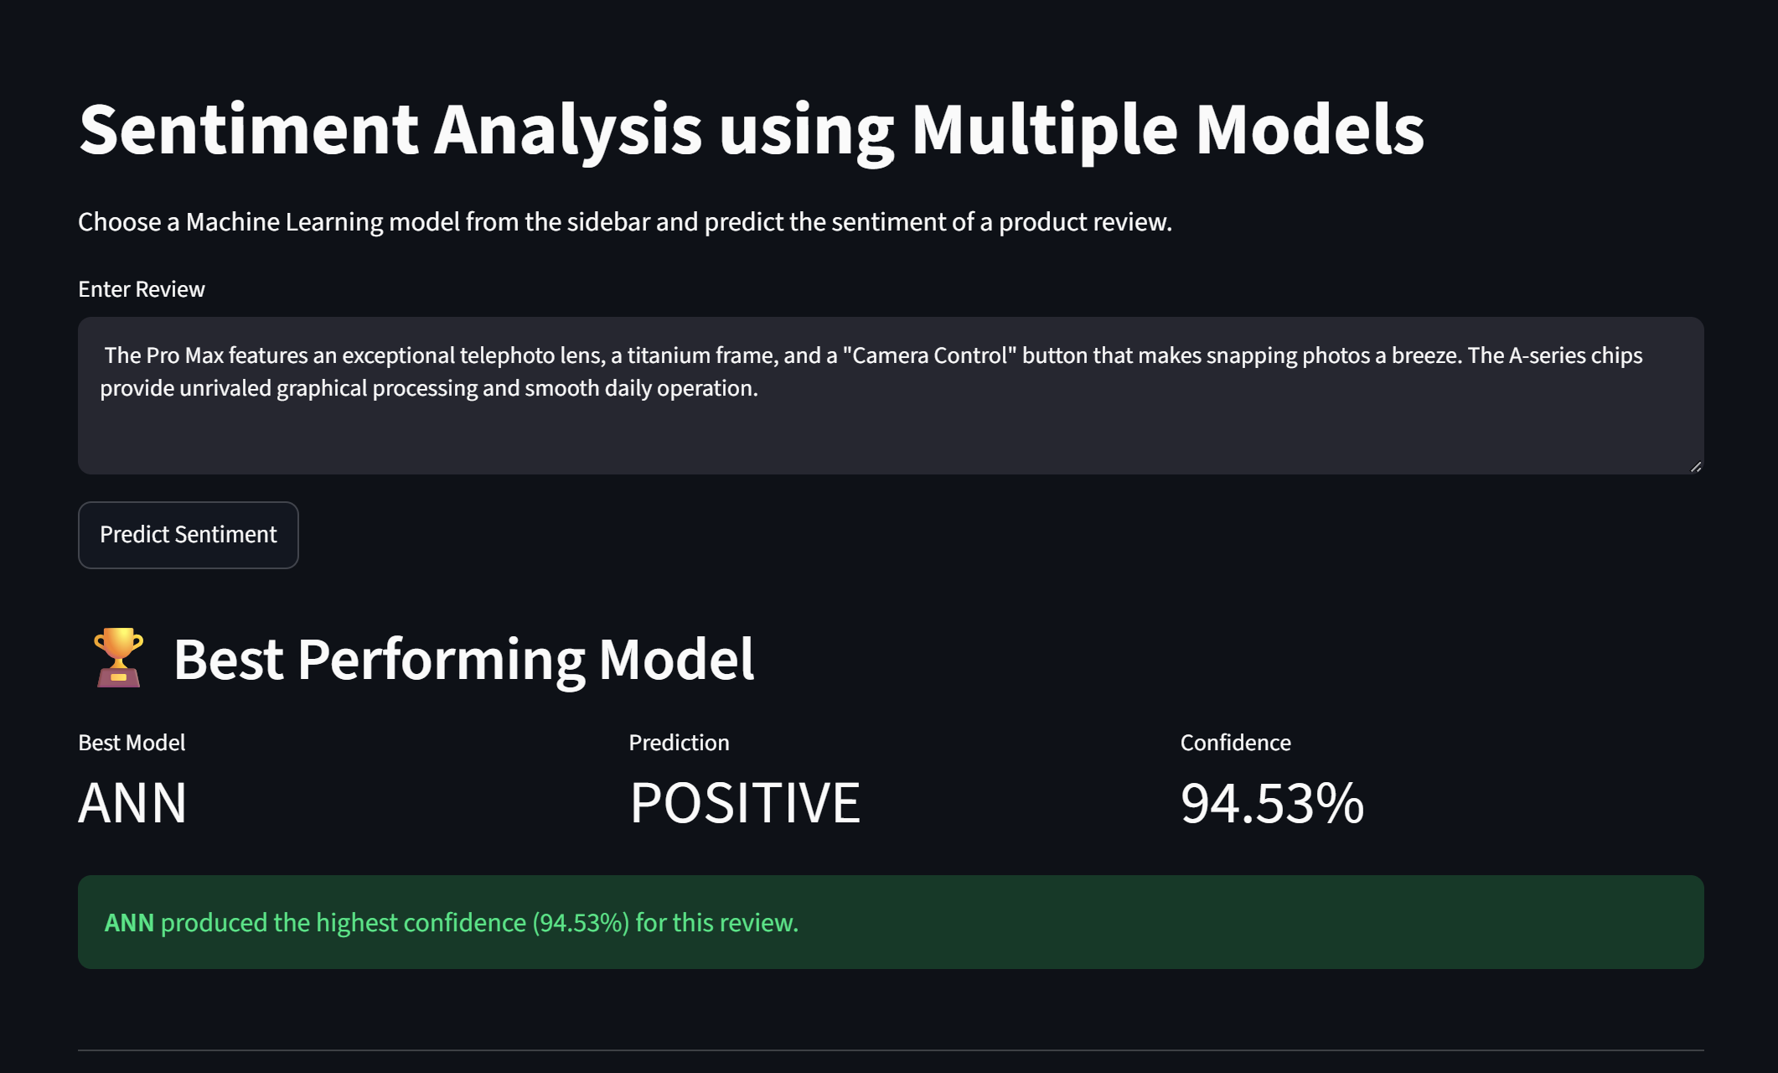
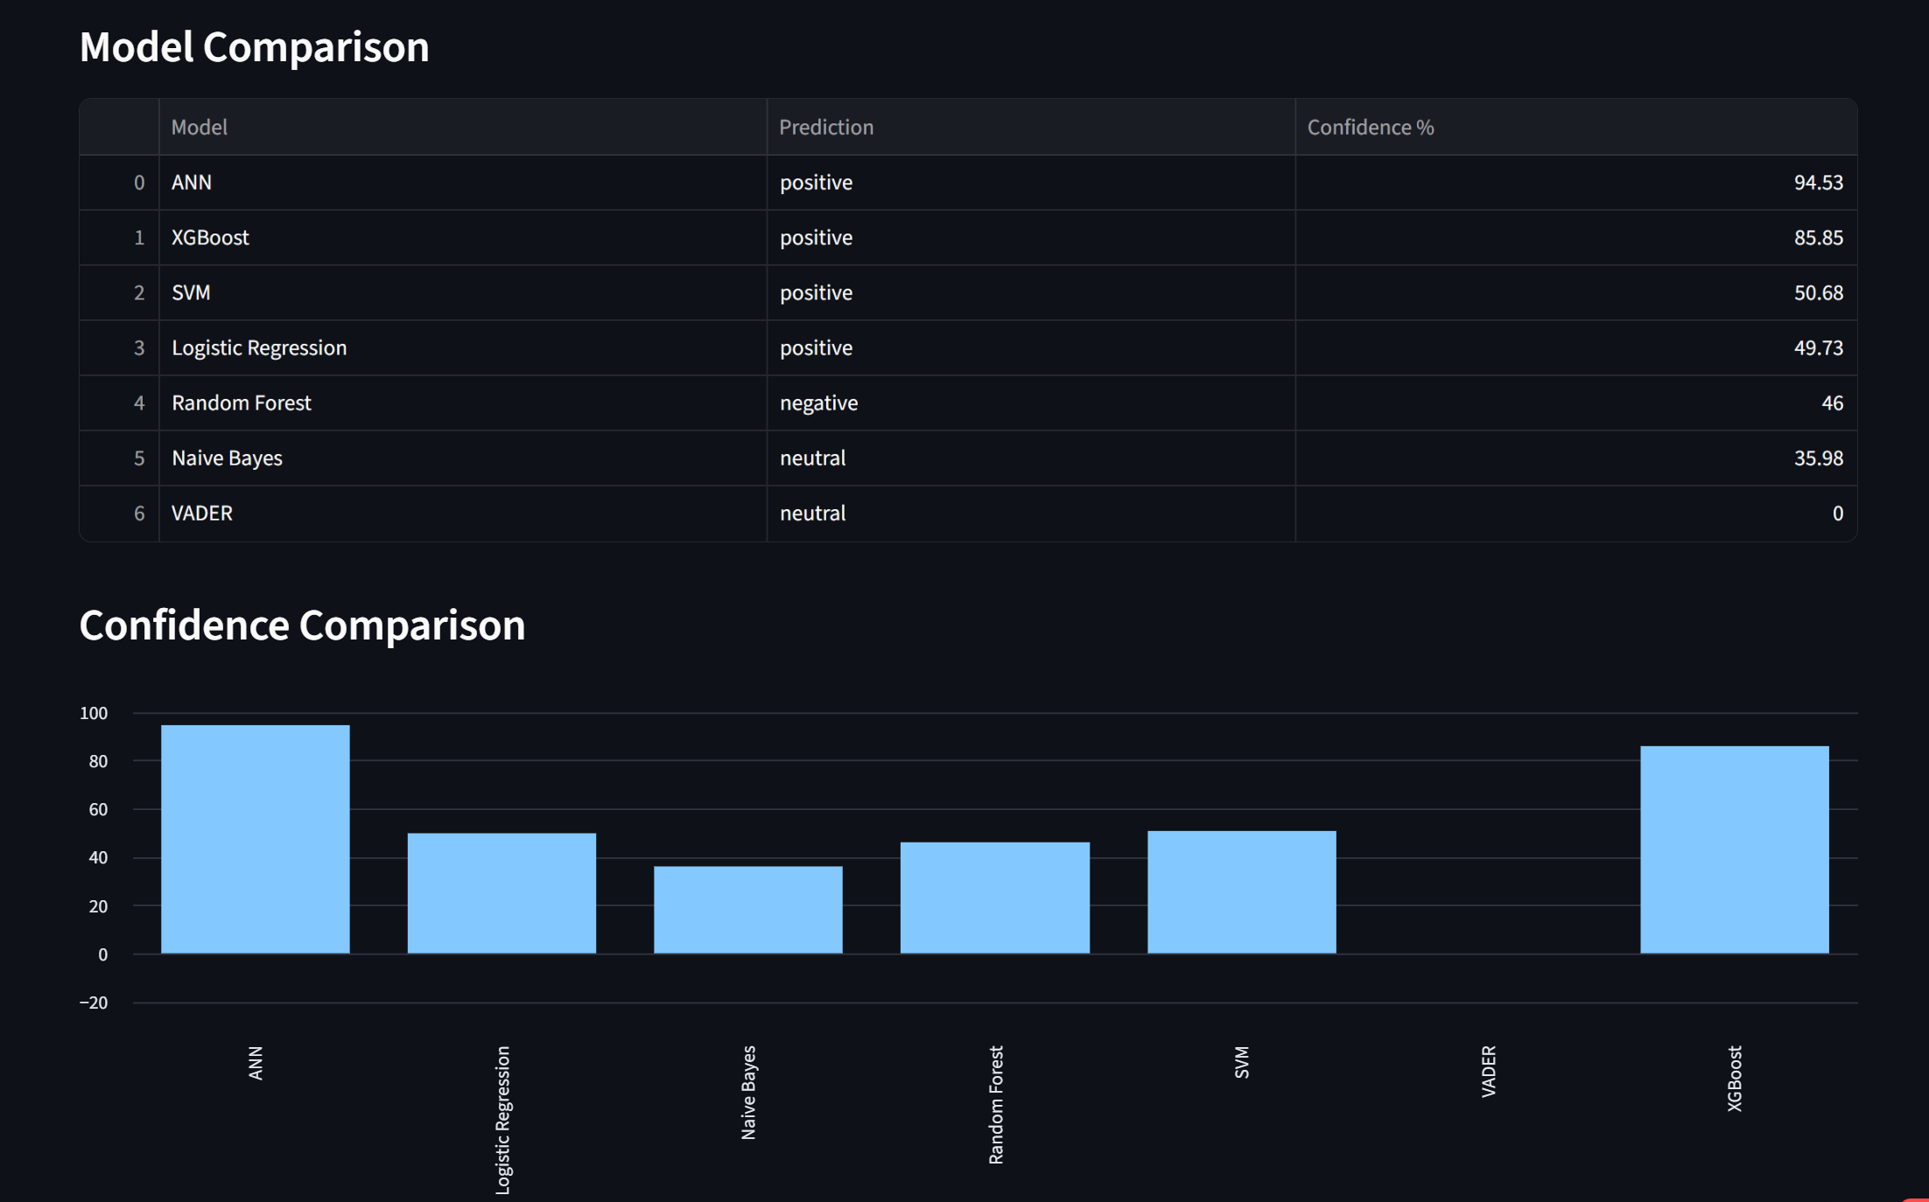
SECTION 07 — DEPLOYMENT
Positive Review
Screenshot of the deployed web application with positive feed back.

Slide 18
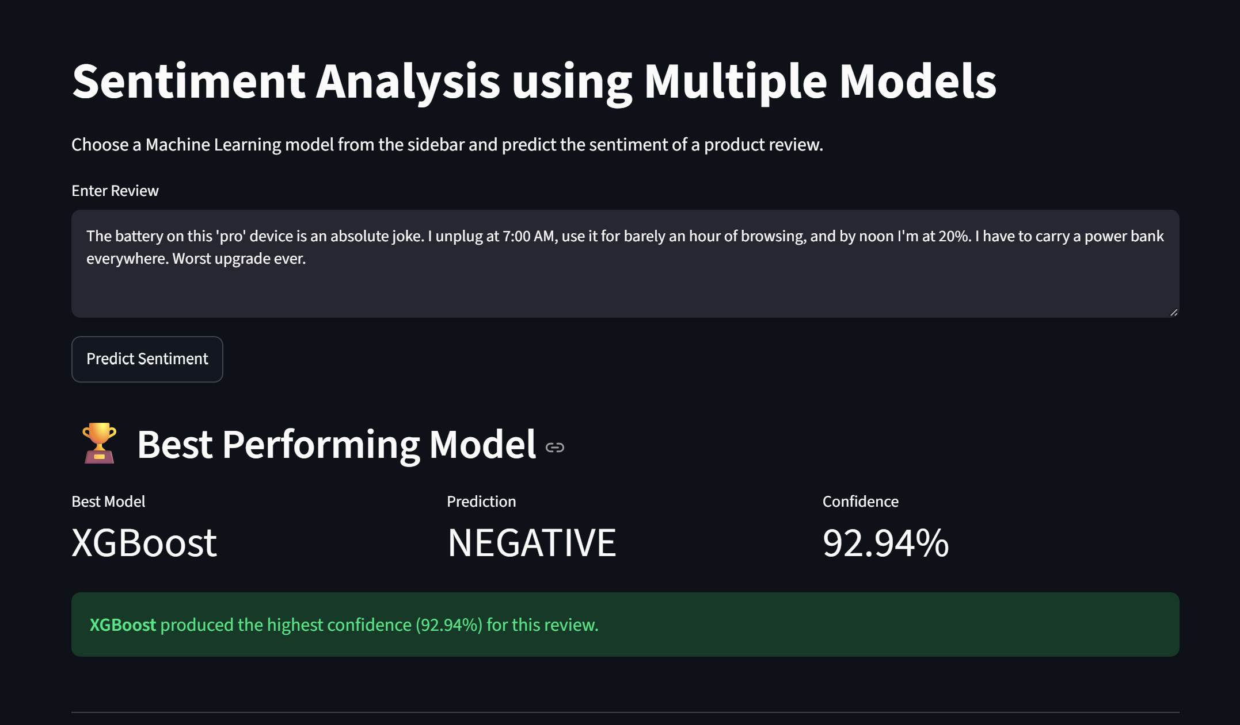
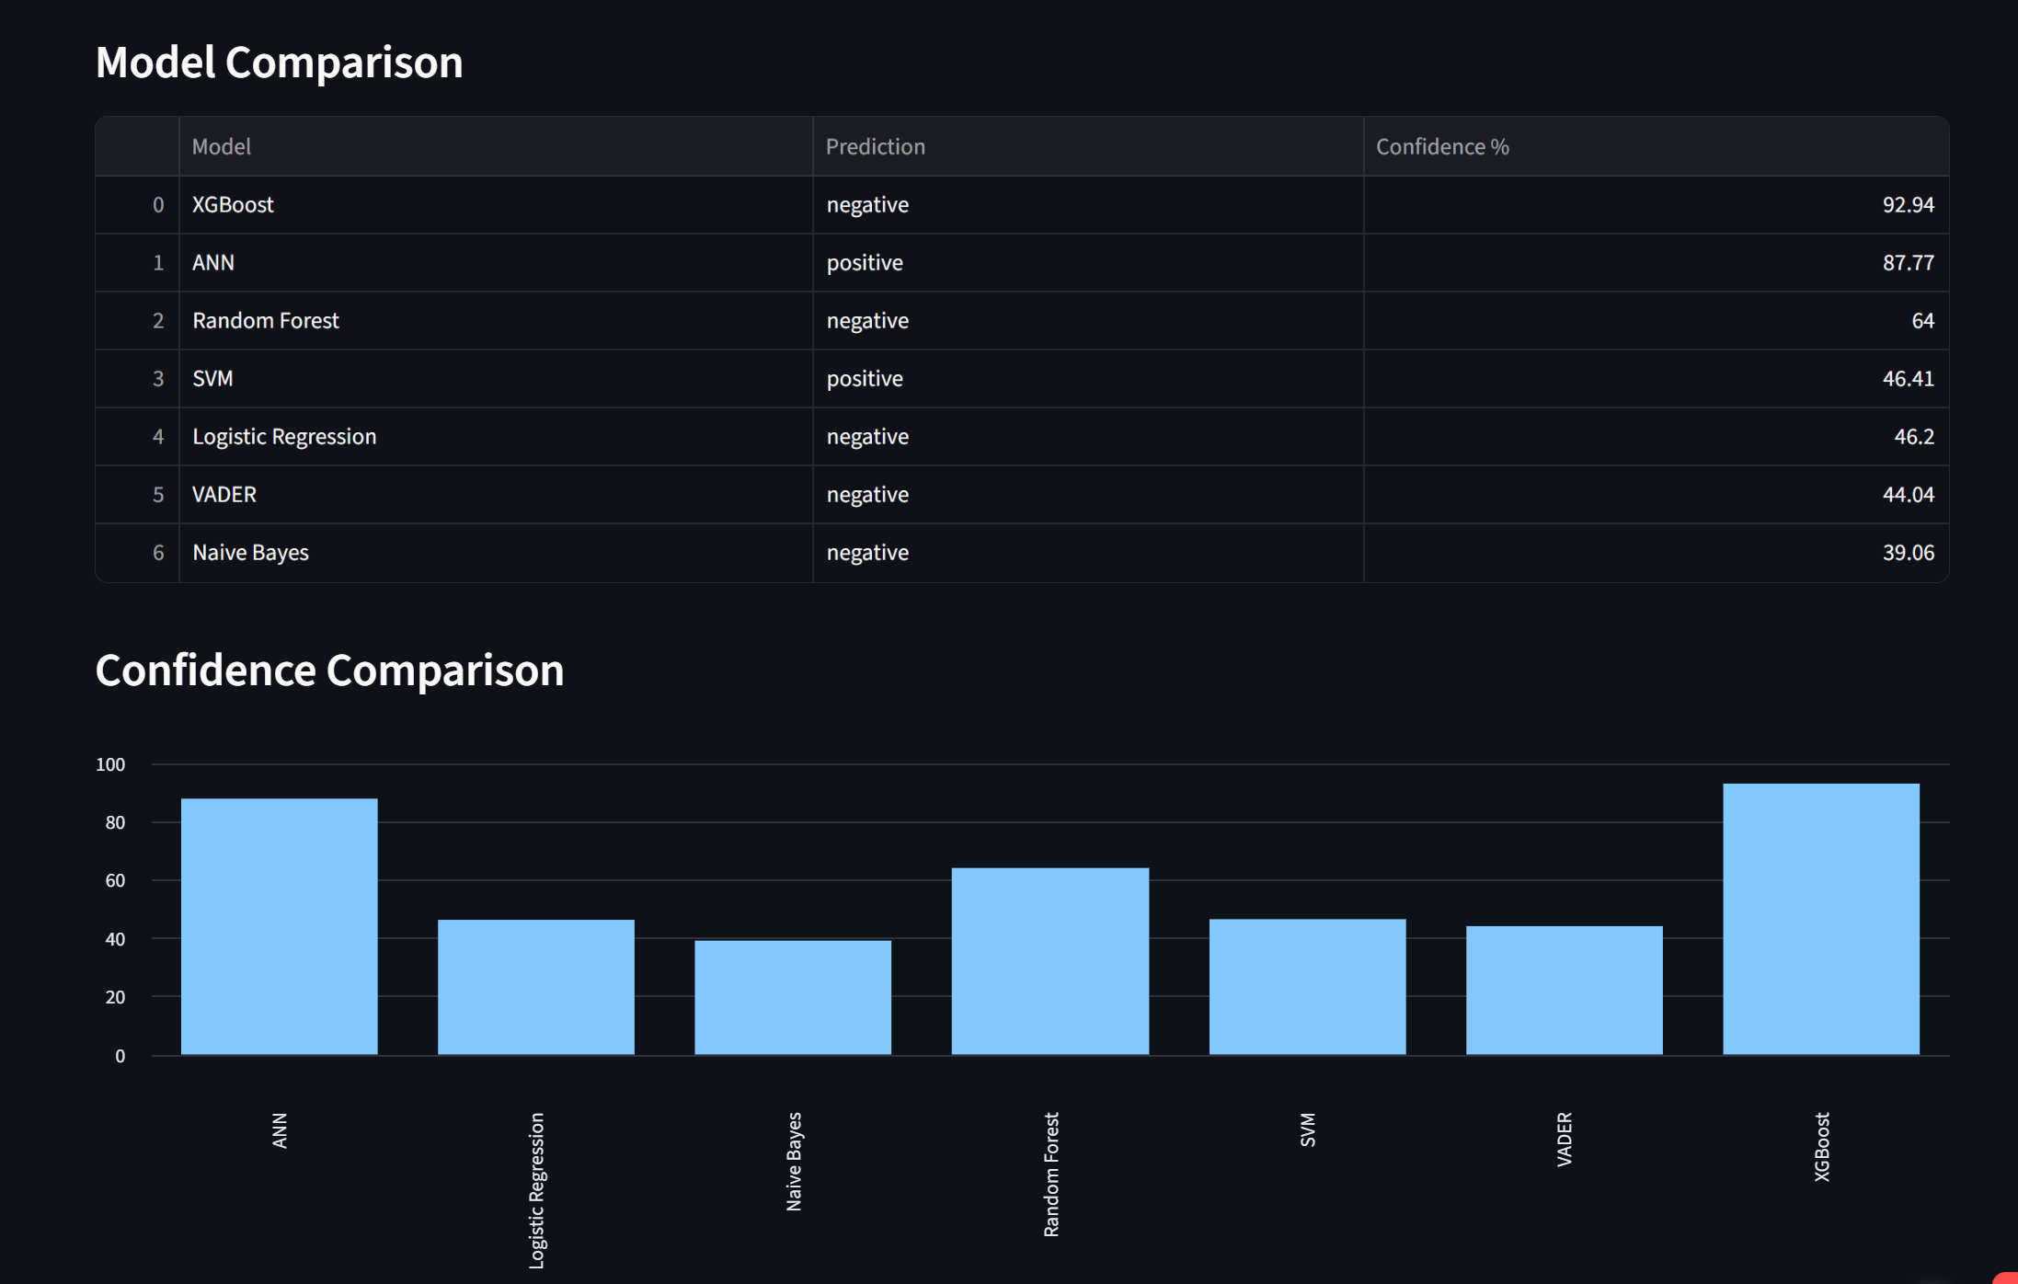
SECTION 07 — DEPLOYMENT
Negative Review
Screenshot of the deployed web application with negative feed back.

Slide 19
SECTION 07 — DEPLOYMENT & ROADMAP
Real-World Challenges
Production NLP rarely looks like a clean textbook example — here is what we navigated.
Imbalanced classes
Sarcasm & mixed signals
Spelling mistakes
Neutral is only 13.8% of data
"Great, another broken phone"
Informal, typo-prone customer text
Flagged as the #1 priority for future oversampling / class-weighting
Documented as a known limitation of lexicon & TF-IDF models
Lemmatization partially normalizes common word-form errors
Short vs. long reviews
Negation handling
Noise & emojis
9 to 2,536 characters in the same set
"not good" vs. "good"
HTML fragments, symbols, emojis
TF-IDF's frequency weighting adapts naturally to length variance
VADER applies rule-based negation; ML models rely on n-gram context
Regex-based cleaning strips non-alphabetic noise pre-vectorization
Notes:
19

Slide 20
SECTION 07 — DEPLOYMENT & ROADMAP
Future Scope & Roadmap
From classical ML to a transformer-powered, multilingual, real-time sentiment platform.
1
2
3
Transformer Models
Aspect-Based Sentiment
Multilingual NLP
BERT, RoBERTa & DistilBERT for contextual, sarcasm-aware sentiment
Separate scores per feature — camera, battery, price — not just overall polarity
Extend beyond English to serve global customer bases
4
5
6
Real-Time Dashboards
Cloud-Native Deployment
LLM-Powered Insights
Live sentiment trend monitoring for product & CX teams
Containerized, auto-scaling API beyond the current Streamlit prototype
Generative summarization of *why* sentiment is shifting, not just *what*
Notes:
20

Slide 21
CONCLUSION
Business Impact & Conclusion
A deployment-ready system that converts raw customer language into measurable business value.
Business Impact
Technical Achievements
Deployment Readiness
Automates triage of 1,440+ reviews that would otherwise require manual reading
Surfaces negative sentiment early enough to act before churn
Gives product teams evidence-based prioritization (camera, battery, price themes)
7-model benchmark built on a shared, reproducible TF-IDF pipeline
79.51% accuracy with the interpretable Logistic Regression winner
Identified and documented the class-imbalance limitation transparently
Live, working Streamlit application — not just a notebook artifact
End-to-end pipeline: raw text → clean → vectorize → predict → display
Clear, prioritized roadmap toward transformer-based upgrades
Notes:
21

Slide 22
Thank You
Questions & Discussion
Live app: sentimental-assignment-ftnbxwy6j4qymnnnxqgbcm.streamlit.app
Dataset: 1,440 customer reviews | Best model: Logistic Regression (79.51% accuracy)
Customer Review Sentiment Analysis | NLP
32 / 32
Notes:
22

